Slide 1


PMIT-6204: Cryptography & Steganography
for
3rd Semester of PMIT Program
Lecture File: 06
Traditional Transposition Ciphers
Prepared by:
Professor K M Akkas Ali
akkas_khan@yahoo.com, akkas@juniv.edu
Institute of Information Technology (IIT)
Jahangirnagar University, Dhaka-1342

Slide 2
Lecture File-06:
Traditional Transposition Ciphers
Topics to be Discussed
To define transposition ciphers:
To illustrate some transposition ciphers:
Keyless cipher
Keyed cipher
Columnar cipher
To introduce the concepts of the stream ciphers and block ciphers
Notes:
2

Slide 3
Transposition Ciphers
What is Transposition Ciphers
A transposition cipher does not substitute one symbol for another, instead it changes the location of the symbols.
A symbol in the first position of the plaintext may appear in the ninth position of the ciphertext. A symbol in the eighth position of the plaintext may appear in the first position of the ciphertext.
Types of Transposition Ciphers
There are three types of transposition cipher:
Keyless Transposition Ciphers
Keyed Transposition Ciphers
- Keyed Columnar Transposition Ciphers or Columnar Transposition Ciphers

Slide 5
Keyless Transposition Ciphers
These are simple transposition ciphers and were used in the past.
There are two methods for permutation of characters:
In the first method, the text is written into a table column by column and then transmitted row by row.
In the second method, the text is written into a table row by row and then transmitted column by column.

Slide 6
Keyless Transposition Ciphers
Example:
1st Method: Written column by column and transmitted row by row
A good example of a keyless cipher using the first method is the rail fence cipher.
In this cipher, the plaintext is arranged in two lines as a zigzag pattern (which means column by column).
The ciphertext is created reading the pattern row by row. For example, to send the message “Meet me at the park” to Bob, Alice writes-
By sending the first row followed by the second row, Alice then creates the ciphertext “MEMATEAKETETHPR”.
Bob receives the ciphertext and divides in half (in this example, the second half has one less character). The first half forms the first row; the second half forms the second row. She reads the result in zigzag.
Because there is no key and the number of rows is fixed (2 here), the cryptanalysis of the ciphertext would be very easy for Eve.

Slide 7
Keyless Transposition Ciphers
Example:
2nd Method: Written row by row and transmitted column by column
Alice and Bob can agree on the number of columns and use the second method. Alice writes the same plaintext, row by row, in a table of four columns.
By transmitting the characters column by column, Alice then creates the ciphertext “MMTAEEHREAEKTTP”.
Bob receives the ciphertext and follows the reverse process. He writes the received message column by column and reads it row by row as the plaintext.
Eve can easily decipher the message if she knows the number of columns.

Slide 8
Keyless Transposition Ciphers
Example:
The cipher in the previous example is actually a transposition cipher. The following shows the permutation of each character in the plaintext into the ciphertext based on the positions.
Plaintext | : | m | e | e | t | m | e | a | t | t | h | e | p | a | r | K
Source Position | : | 01 | 02 | 03 | 04 | 05 | 06 | 07 | 08 | 09 | 10 | 11 | 12 | 13 | 14 | 15
 |  |  |  |  |  |  |  |  |  |  |  |  |  |  |  | 
Destination Position | : | 01 | 05 | 09 | 13 | 02 | 06 | 10 | 14 | 03 | 07 | 11 | 15 | 04 | 08 | 12
Ciphertext | : | M | M | T | A | E | E | H | R | E | A | E | K | T | T | P
The first character in the plaintext has not changed its position. The second character in the plaintext has moved to the fifth position in the ciphertext; the third character has moved to the ninth position; and so on.
Although the characters are permuted, there is a pattern in the permutation: (01, 05, 09, 13), (02, 06, 10, 14), (03, 07, 11, 15), and (04, 08, 12). In each section, the difference between the two adjacent numbers is 4.

Slide 9
Keyed Transposition Ciphers
The keyless ciphers permute the characters by using writing plaintext in one way (e.g. row by row) and reading it in another way (e.g. column by column). The permutation is done on the whole plaintext to create the whole ciphertext.
In keyed transposition cipher, the plaintext is divided into groups of predetermined size, called blocks, and then use a key to permute the characters in each block separately.

Slide 10
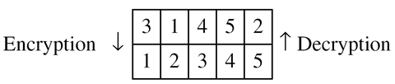
Keyed Transposition Ciphers
Example:
Alice needs to send the message “Enemy attacks tonight” to Bob.
They have agreed to divide the text into groups of five characters and then permute the characters in each group.
To make the last group the same size, a bogus character z is added at the end.
The key used for encryption and decryption is a permutation key, which shows how the character are permuted. For the above message, we assume that Alice and Bob used the following key:
The third character in the plaintext block becomes the first character in the ciphertext block.
Similarly, the first character in the plaintext block becomes
the second character in the ciphertext block , and so on.
The permutation yields:
Alice sends the ciphertext “EEMYNTAACTTKONSHITZG” to Bob. Bob divides the ciphertext into 5-character groups and finds the plaintext using the key in reverse order.

Slide 11
Columnar Transposition Ciphers
This type of transposition cipher combines the keyless and keyed transposition ciphers to achieve better scrambling.
Encryption or decryption is done in three steps:
The text is written into a table row by row.
The permutation is done by reordering the columns.
The new table is read column by column.
Here, the 1st and 3rd steps provide a keyless global reordering and the 2nd step provides a blockwise keyed reordering.

Slide 12
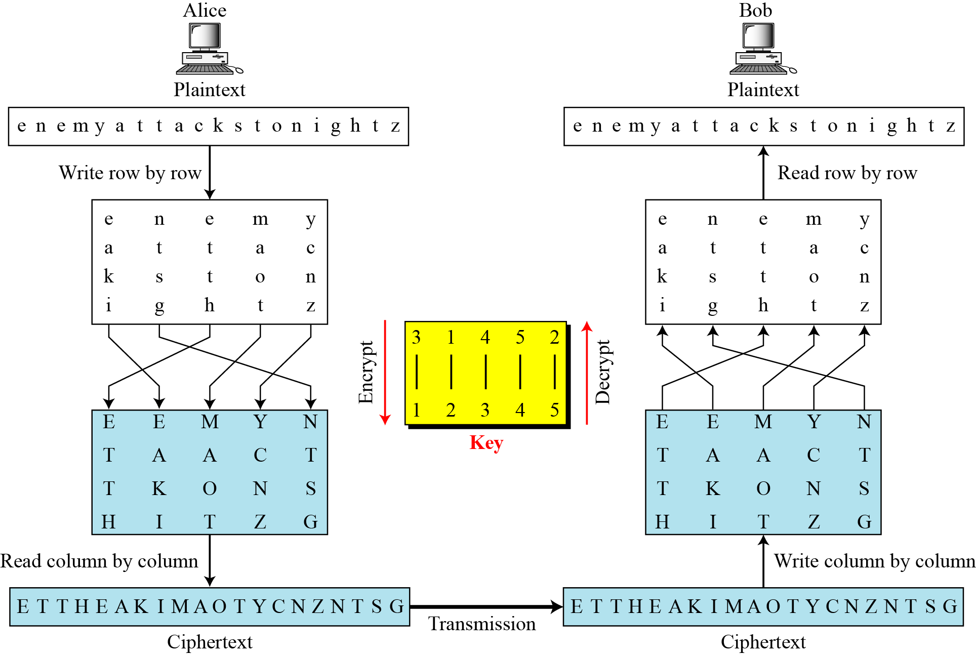
Columnar Transposition Ciphers
Example:
Encrypt the message “enemy attacks tonight” using Columnar transposition cipher.
Solution: The encryption and decryption is illustrated in the figure below.
The 1st table in the figure is created by Alice writing the plaintext row by row.
The columns are permuted using the key mentioned.
The ciphertext is created by reading the 2nd table column by column.
Bob does the same three steps in the reverse order.
Figure: Combining Two Approaches

Slide 13
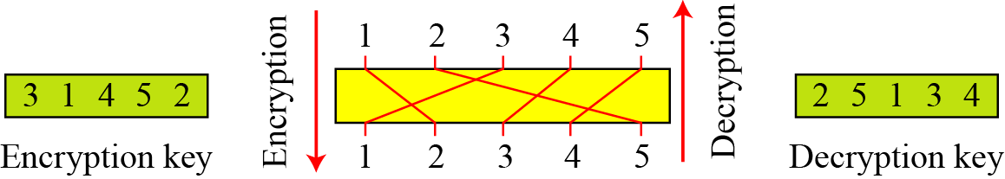
Columnar Transposition Ciphers
Keys
In the previous example, a single key was used in two directions for the column exchange:
downward for encryption
upward for decryption.
It is customary to create two keys.
Figure: Encryption/decryption keys in transpositional ciphers

Slide 14
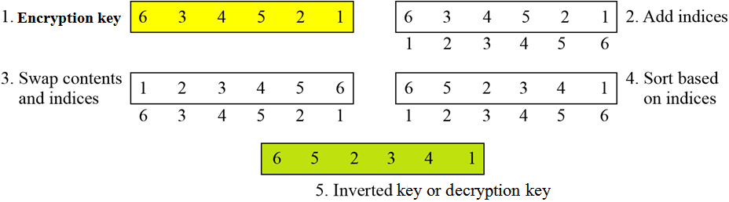
Key inversion in a transposition cipher
How can the inverse of a key be created if the initial or original key is given, or vice versa?
The process can be done manually in a few steps.
Figure below shows how to invert an encryption key, i.e. how to find the decryption key.
Figure: Inverting a permutation table
Notes:
14

Slide 15
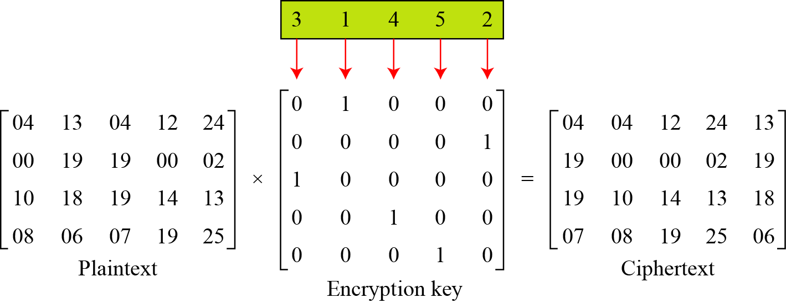
Columnar Transposition Ciphers
Using Matrices
We can use matrices to show the encryption/decryption process for a transposition cipher.
Figure below shows the encryption process.
Multiplying the 4 × 5 plaintext matrix by the 5 × 5 encryption key gives the 4 × 5 ciphertext matrix.
Figure: Representation of the key as a matrix in the transposition cipher

Slide 16
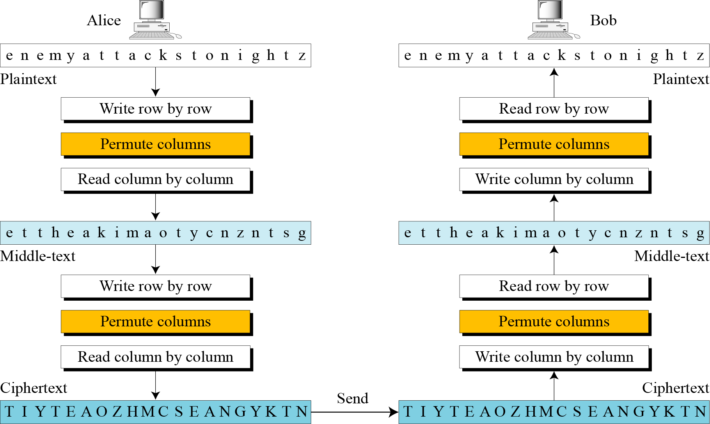
Double Transposition Ciphers
Example:
Figure: Double transposition cipher

Slide 17
Traditional Vs. Modern Symmetric-key Ciphers:
The traditional symmetric-key ciphers were used in the past. They are character-oriented ciphers.
Traditional ciphers are simpler than modern ciphers and easier to understand. They can be easily attacked using a computer.
Two broad categories of traditional symmetric-key ciphers are:
Traditional substitution ciphers
Traditional transposition ciphers
Now-a-days, the information to be encrypted is not just text; it can also consist of numbers, graphics, audio, and video data. It is convenient to convert these types of data into a stream of bits, to encrypt the stream, and then to send the encrypted stream. So, we need bit-oriented ciphers.
When data is treated as the collection of bits, it becomes larger. Mixing a larger number of symbols increases security.
Two broad categories of modern symmetric-key ciphers are:
Modern stream ciphers
Modern block ciphers

Slide 18
Stream Ciphers:
Stream cipher encrypts a single character or bit of plaintext at a time. It also decrypts a single character or bit of ciphertext at a time.
Example:
Given plaintext: 10011011110100001 Let the keystream be a stream of 1s and 0s.
If we use an exclusive or (XOR) with the keystream and plaintext, we get ciphertext.
This keystream is called periodic, since the sequence '10' repeats over and over.
Plaintext : 10011011110100001 Keystream : 10101010101010101 Ciphertext : 00110001011110100 (by XORing each plaintext bit with corresponding keystream bit)
To decrypt this ciphertext, all we need to do is again XOR the ciphertext with the keystream:
Ciphertext : 00110001011110100 Keystream : 10101010101010101 Plaintext (XOR) : 10011011110100001
Notes:
18

Slide 19
Block Ciphers:
A symmetric-key modern block cipher encrypts an n-bit block of plaintext or decrypts an n-bit block of ciphertext together.
The decryption algorithm must be the inverse of the encryption algorithm.
If the message has the fewer than n bits, padding must be added to make it an n-bit block. If the message has more than n bits, it should be divided into n-bit blocks and the appropriate padding must be added to the last block if necessary.
The common values of n are 64, 128, 256, or 512 bits.
Example
Plaintext : The only thing we have to fear is fear itself
Modified plaintext : Theonlythingwehavetofearisfearitself
Plaintext blocks : Theonlyt hingweha vetofear isfearit selfXend (break the plaintext into 8-character block)
Ciphertext blocks : tylnoehT ahewgnih raefotev tiraefsi dneXfles (just reverse each plaintext block)
Ciphertext : tylnoehTahewgnihraefotevtiraefsidneXfles

Slide 20
Discussion Points
To define transposition ciphers:
To illustrate some transposition ciphers:
Keyless cipher
Keyed cipher
Columnar cipher
To introduce the concepts of the stream ciphers and block ciphers

Slide 21

Have a question?
Thank you…

